Slide 1

Video Tour

Slide 2
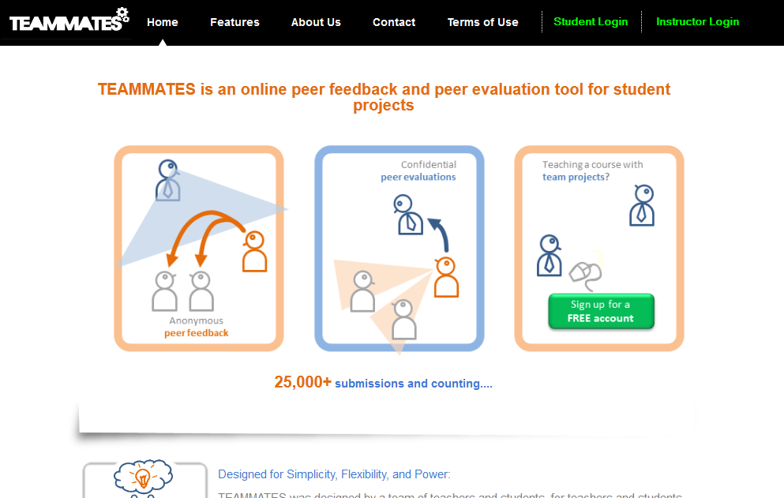
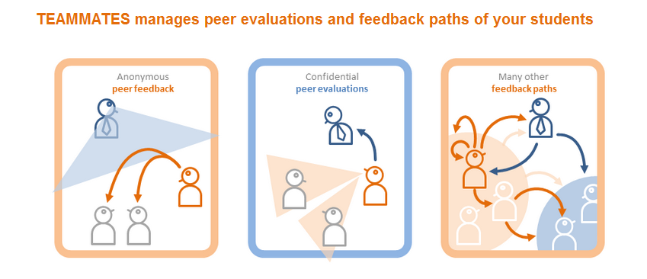
Video Tour

Slide 3
Video Tour

Slide 4
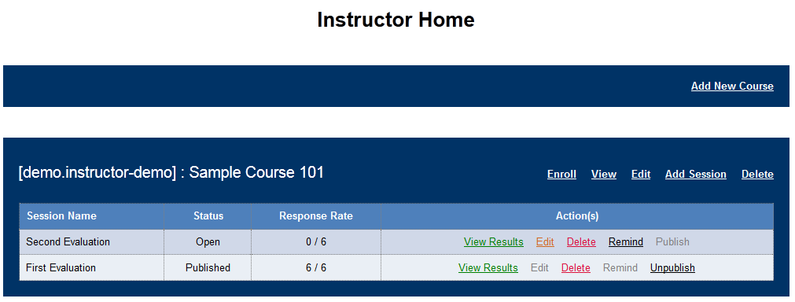
Sample data that come with new accounts

Slide 5

Create a new course

Slide 7
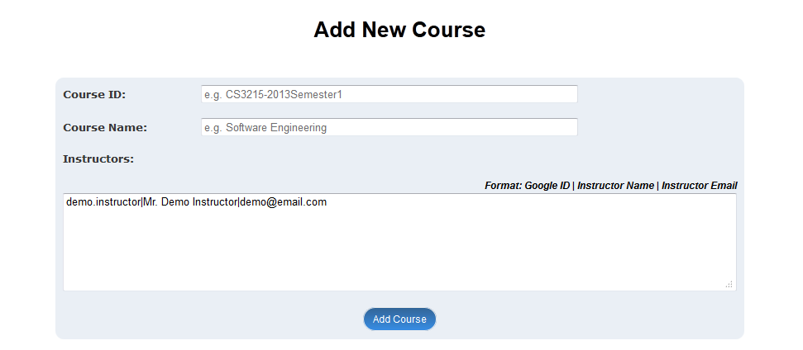

Hover over items to see helpful tips
Enter a unique ID for the course. E.g., CS101-2013-Sem1

Slide 8
Fill in the course details
ECON101-2013Fall
Introduction to Economics

Slide 9
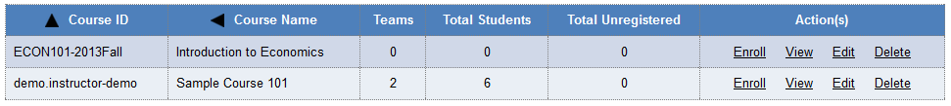
New course created
Enroll students in the new course

Slide 11
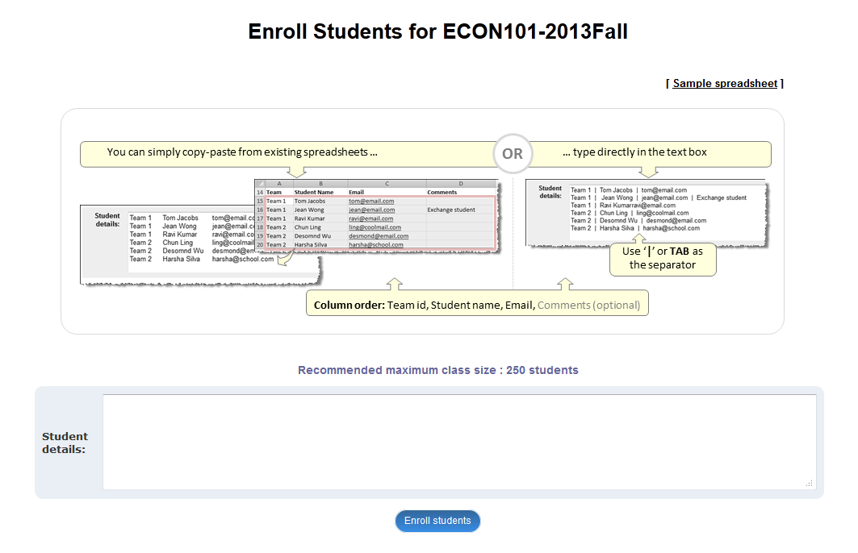
Instructions are here

Slide 12
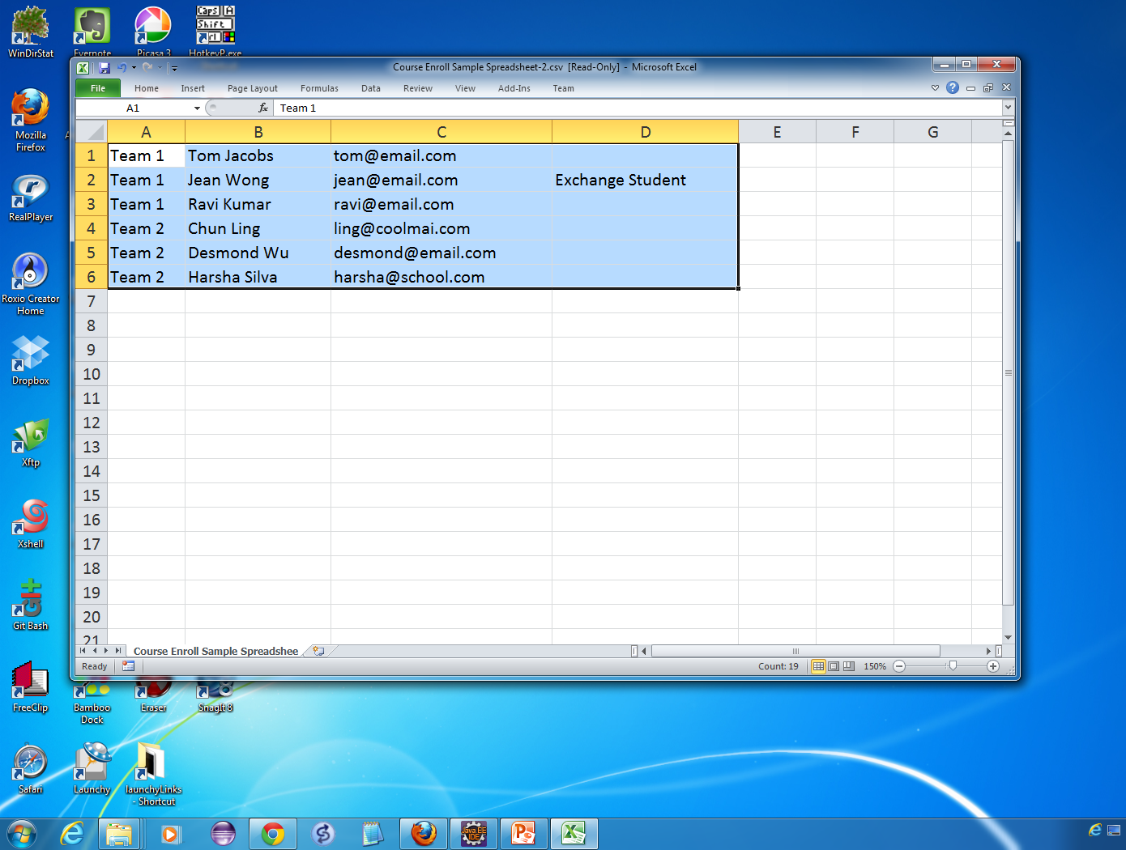
Copy student data

Slide 13
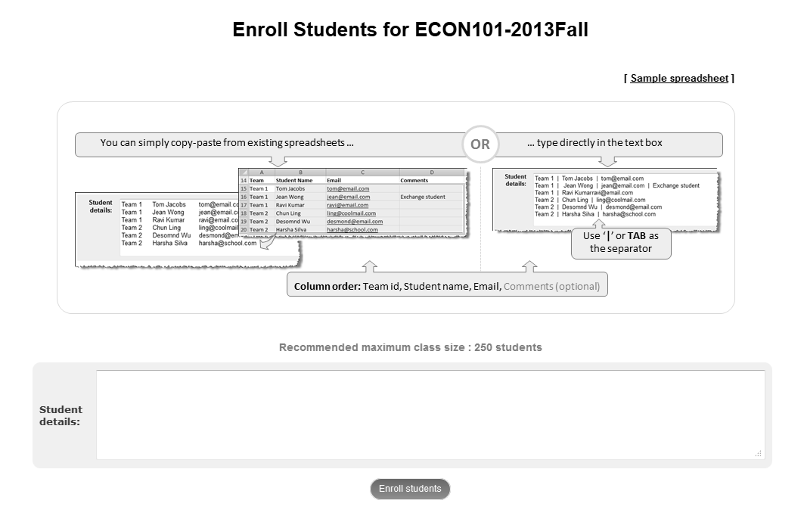
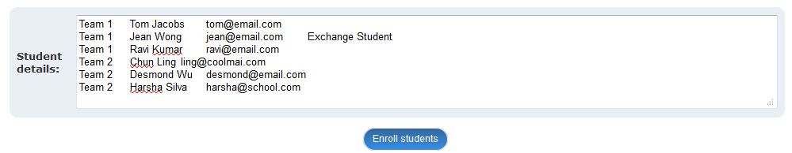
Team 1 Tom Jacobs tom@email.com
Team 1 Jean Wong jean@email.com Exchange Student
Team 1 Ravi Kumar ravi@email.com
Team 2 Chun Ling ling@coolmail.com
Team 2 Desmond Wu desmond@email.com
Team 2 Harsha Silva harsha@school.com
Paste here

Slide 15
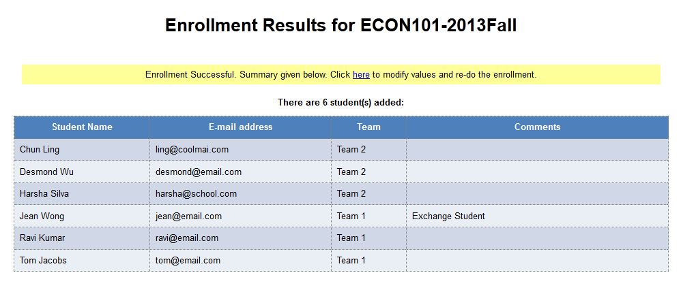
Next, create a new session
Students enrolled

Slide 17
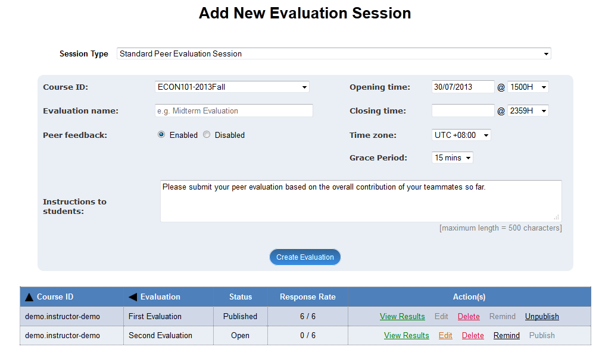
Choose session type:
Option 1. Preset questions. Optimized for peer evaluations in team projects.
Option 2. Set your own questions, feedback paths, and visibility levels.

Slide 18
Choose session type:
Option 1. Preset questions. Optimized for peer evaluations in team projects.
Option 2. Set your own questions, feedback paths, and visibility levels.

Slide 19
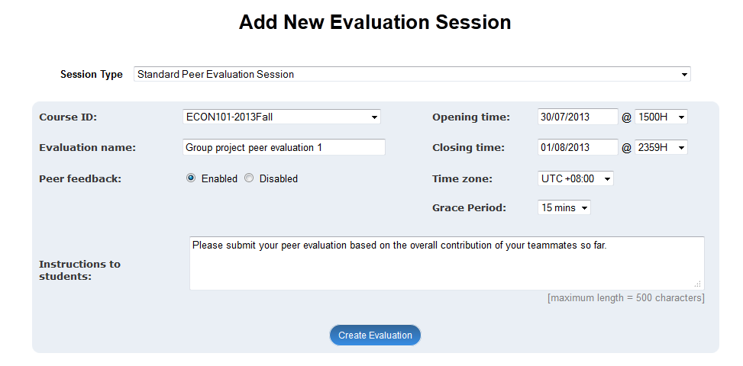
Choose session type:
Option 1. Preset questions. Optimized for peer evaluations in team projects.
Fill in the data

Slide 20
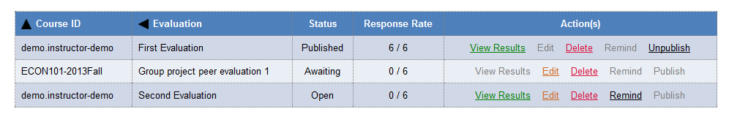

Slide 21
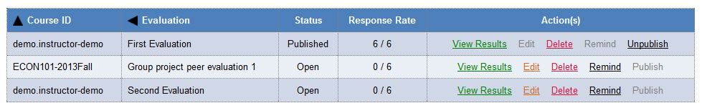
New session added
At the session opening time …

Slide 22
Student View →

Slide 23
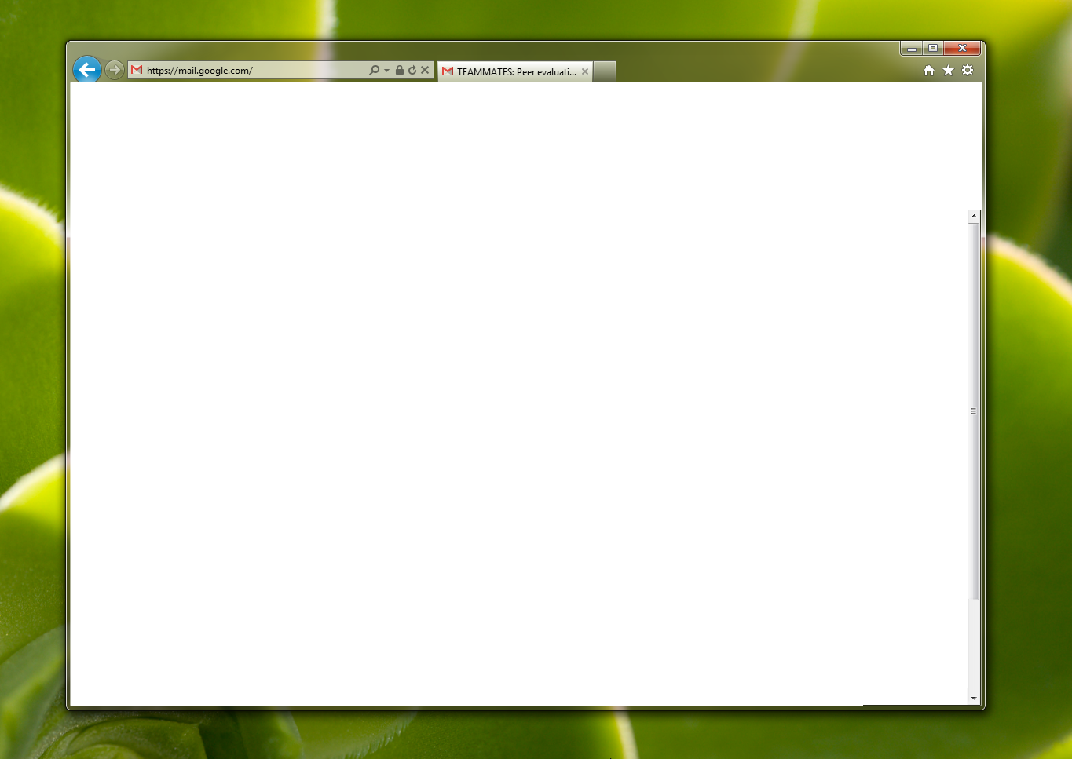
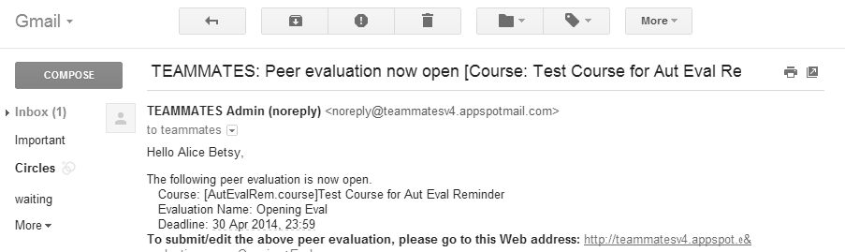
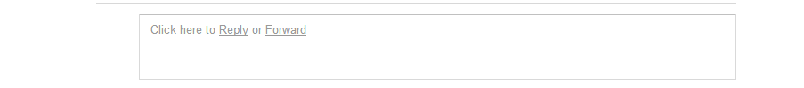
TEAMMATES: [ECON101-2013Fall] Introduction to Economics
Hello Tom Jacobs,
The following peer evaluation is now open. Course: [ECON101-2013Fall]Introduction to Economics Evaluation Name: Group project peer evaluation Deadline: 30 Apr 2014, 23:59
To join the course and submit evaluations, click here
Regards, TEAMMATES Team.
… students receive email alerts.

Slide 25
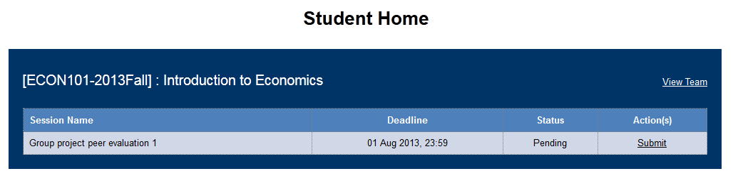

Slide 27
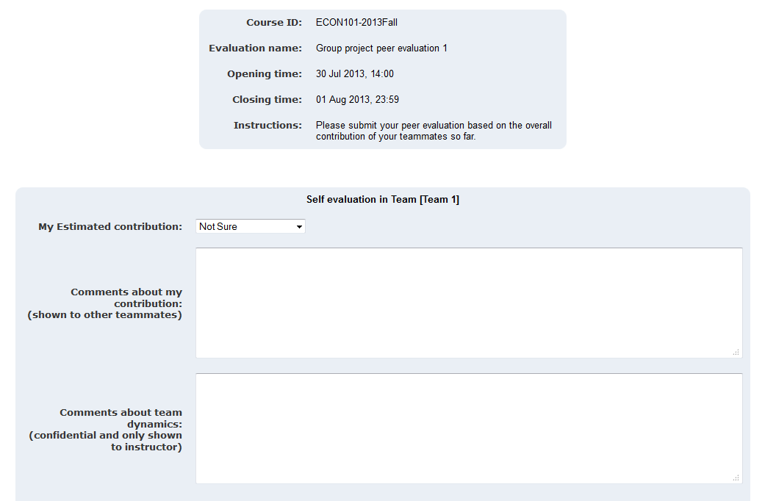
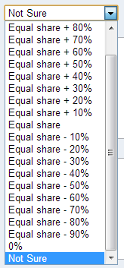
Students estimate own/peer contributions

Slide 28
Students estimate own/peer contributions
Equal Share + 10%
I was the team leader for this round, appointed by a vote.
I coordinated most of the work and did the research component on my own.
Our team got to a slow start but things are moving smoothly now.
There is a high level of team spirit at this stage.

Slide 29
Students estimate own/peer contributions
Equal Share + 10%
I was the team leader for this round, appointed by a vote.
I coordinated most of the work and did the research component on my own.
Comments about own contribution
Our team got to a slow start but things are moving smoothly now.
There is a high level of team spirit at this stage.
Comments about team dynamics

Slide 30
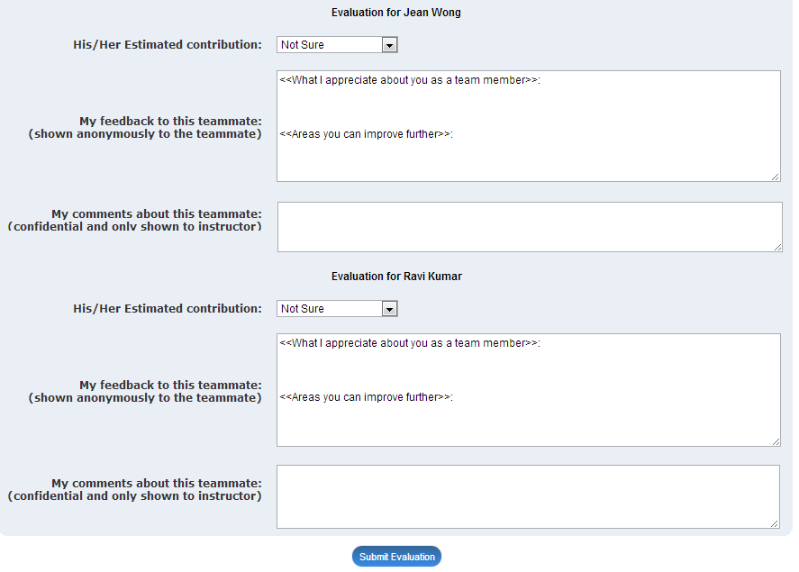
Equal Share + 10%
Always punctual. Quick to reply to emails. Does what she promised, on time. It is great to have you in our team.
Anonymous feedback to peer.
Participate more in discussions. Don’t be scared to voice out your ideas.
Slow starter, but now OK. What she lacks in ability, she makes up for in attitude.
Confidential comments to instructor.
Equal Share -10%
Your enthusiasm at meetings. You are very good and running a meeting and keeping things on track.
Deliver what you promised. Your contribution between meetings can be improved.
Good in meetings, but rarely delivers on time.
Probably too busy with other courses.

Slide 32
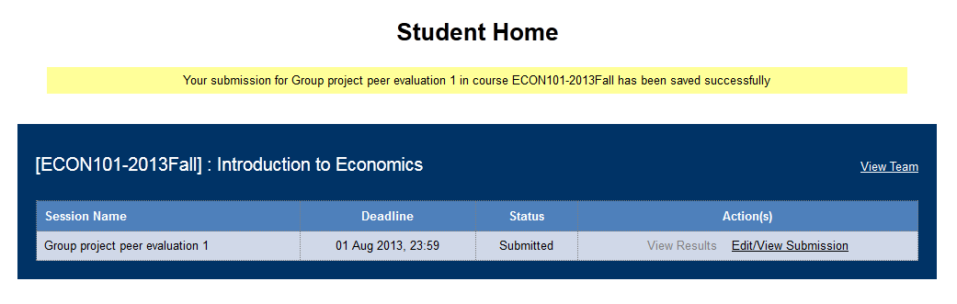
Can edit until closing time.

Slide 33
← Instructor View

Slide 34
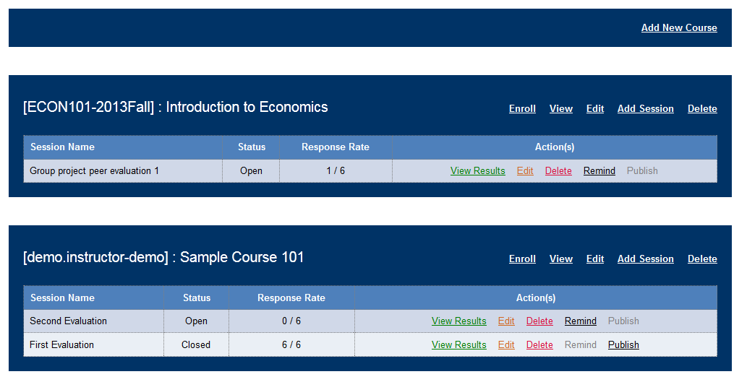
Instructors can view session results.

Slide 36

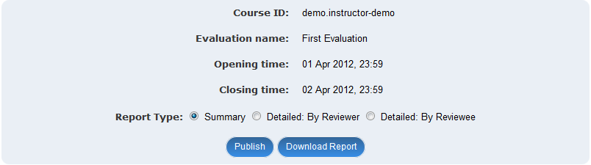
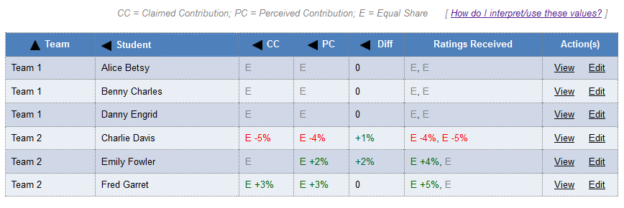
View more detailed reports…
See contribution levels at a glance…

Slide 37
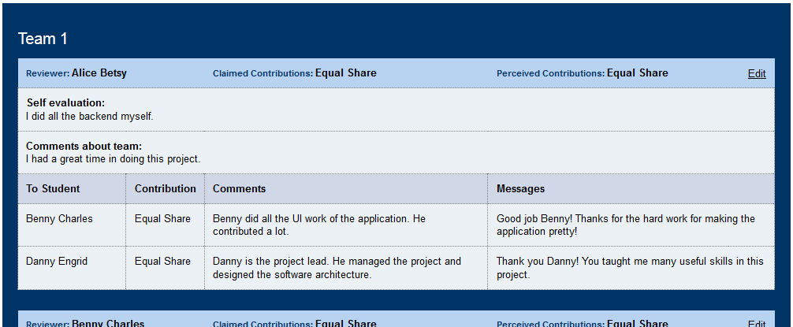
Publish to students
Moderate
submissions

Slide 38
Student View →

Slide 39
TEAMMATES: [ECON101-2013Fall] Group project peer evaluation
Hello Emily Fowler,
The following peer evaluation results are now published. Course: [ECON101-2013Fall]Introduction to Economics Evaluation Name: Group project peer evaluation Deadline: 30 Apr 2014, 23:59
To view results, click here
Regards, TEAMMATES Team.
… students receive link to results.

Slide 40


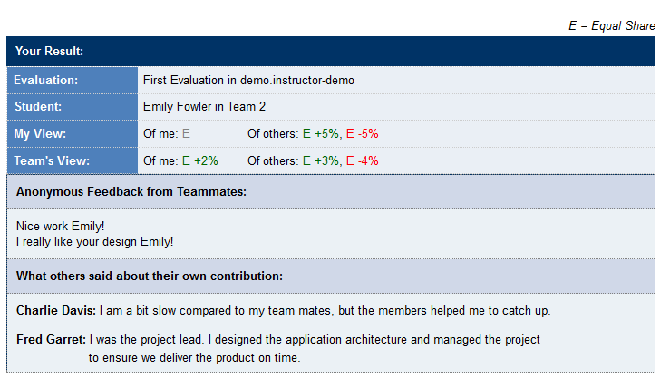
Can compare own perception to team perception.
Comments from peers.
Comments from peers.

Slide 41
← Instructor View

Slide 42
Choose session type:
Option 1. Preset questions. Optimized for peer evaluations in team projects.
Option 2. Set your own questions, feedback paths, and visibility levels.

Slide 43
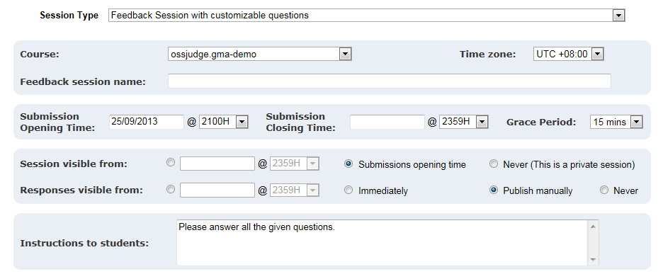
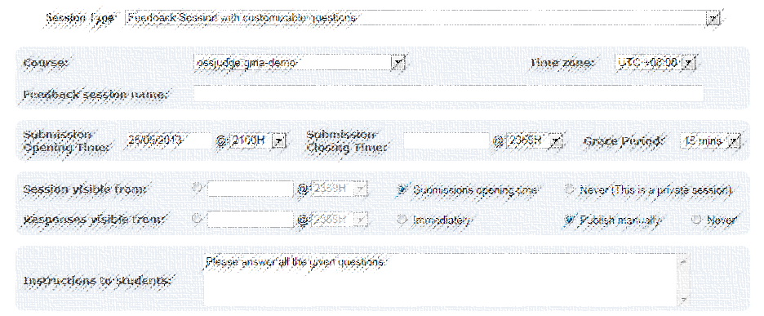
Choose session type:
Option 2. Set your own questions, feedback paths, and visibility levels.

Slide 44
Option 2. Set your own questions, feedback paths, and visibility levels.

Slide 45
Option 2. Set your own questions, feedback paths, and visibility levels.
More flexibility: e.g. Create private sessions to record your observations about students.

Slide 46
More flexibility: e.g. Create private sessions to record your observations about students.
e.g. Make responses visible as they are collected.

Slide 48
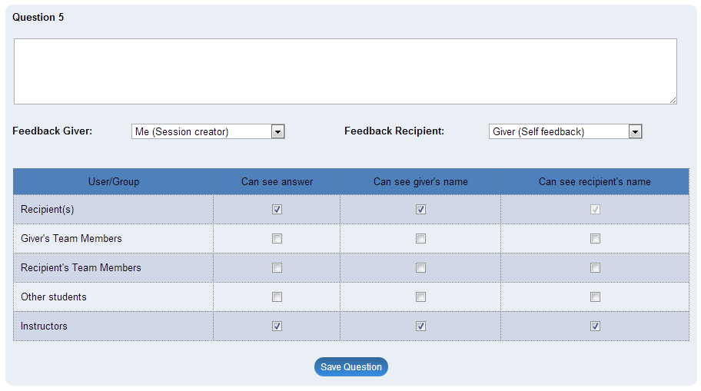

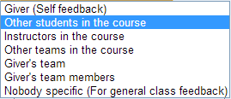
Tutor comments about individual presentations

Slide 49
Comment on other team presentations

Slide 50
Comment on other team presentations

Slide 51
Comment on other team presentations

Slide 52
Comment on other team presentations
… and many other feedback paths

Slide 54
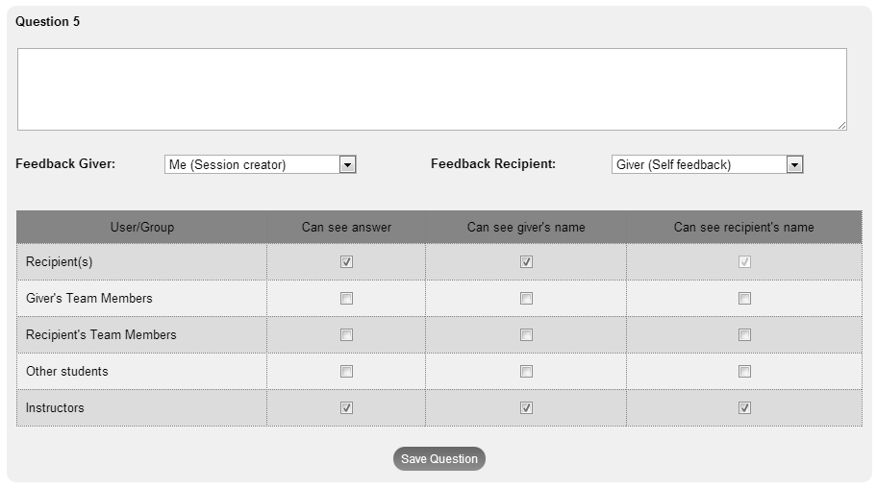
… and per question
visibility settings

Slide 55
See here for more details.
http://TeammatesOnline.info

